Slide 1


Slide 2
Aware User Interface
Owais Zahid

Slide 3

What is ‘Aware User Interface’
Aware User interface is an arrangement that learns, adapt and evolve according to user’s context.

Slide 4
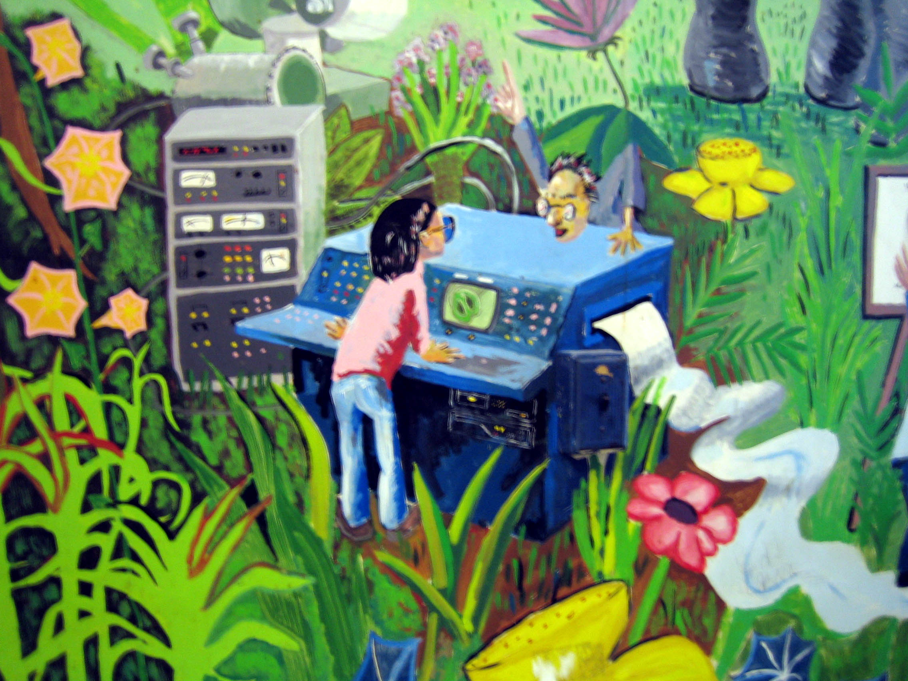
Key Factors: “Environment”
User interface of a system should learn from environment and continues to evolve with it.

Slide 5

Key Factors: “Surrounding”
User interface of a system should learn from user’s surrounding and continue to evolve with it.

Slide 6
Can we measure it?
Self reported: questionnaires, interviews, survey etc.
Physiological: observational methods such as facial expressions, speech analysis, eye tracking etc.
Behavioural: web analytics, task completion, time on task etc.

Slide 7
Demo

Slide 8


Design concerns

Slide 9



Design concerns

Slide 10
Thank you

